Slide 1
SpeakOut with Advocatr
Curriculum
Lesson 7
Accountability for What? To Whom?

Slide 2
“Become an Upstander”
https://www.youtube.com/watch?v=StPGbbBBrI0

Slide 3
“The Importance of Upstander Power”
https://www.youtube.com/watch?v=JegGjYtstyw

Slide 4
In Your Journal:
Write about a time when you (or another person) stood up for someone who was getting picked on. What made you/ them decide to act or speak up?
OR
Write a response (either agree or disagree and explain) to this statement: “You are always using your power, in every moment, to influence the world around you, just by being there. Your choice is not WHETHER you have power; it’s HOW are you using it.”

Slide 5
SpeakOut with Advocatr
Curriculum
Lesson 7 Extension Activities
Freedom and Responsibility
Accountability to our own goals
Making Amends

Slide 6
After reviewing your goals from Week 1, answer these questions in your journal:
Did you hold yourself accountable for working on the goals you set out? If yes, describe what that looked like; if not, describe what it might have looked like.
Did anyone else hold you accountable for those goals?
How does our ability to achieve (or at least work toward) goals change when someone else is checking on our progress?

Slide 7
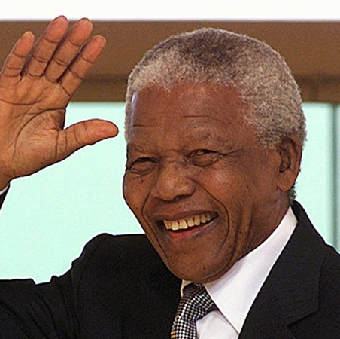
"To be free is not merely to cast off one's chains, but to live in a way that respects and enhances the freedom of others. "
-- Nelson Mandela
This Photo by Unknown author is licensed under CC BY-NC-ND.

Slide 8
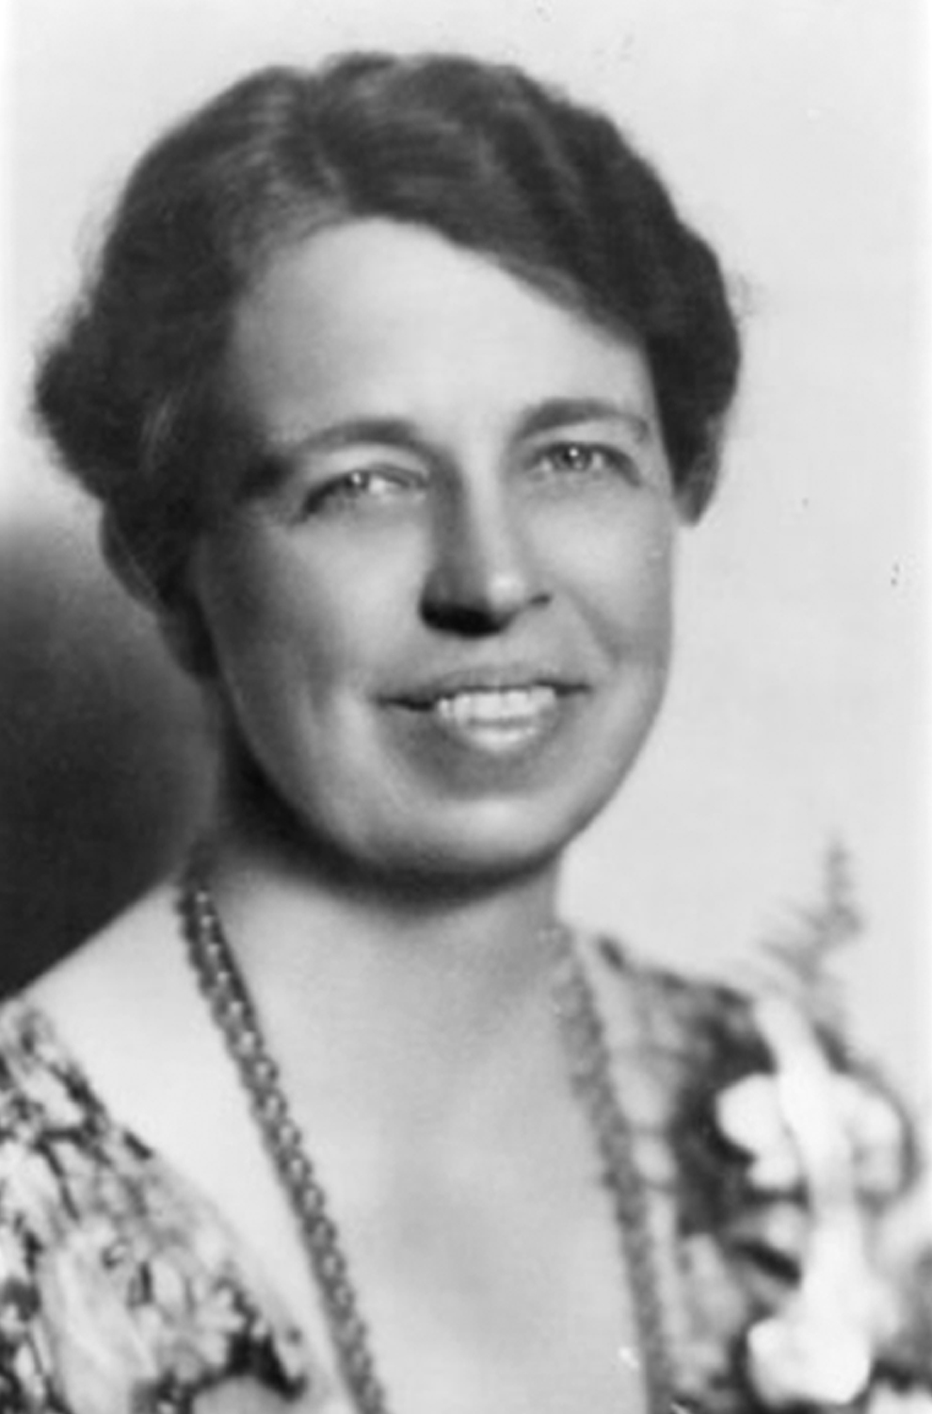
“Freedom makes a huge requirement of every human being. With freedom comes responsibility. For the person who is unwilling to grow up, the person who does not want to carry his own weight, this is a frightening prospect.”
-Eleanor Roosevelt

